Slide 1
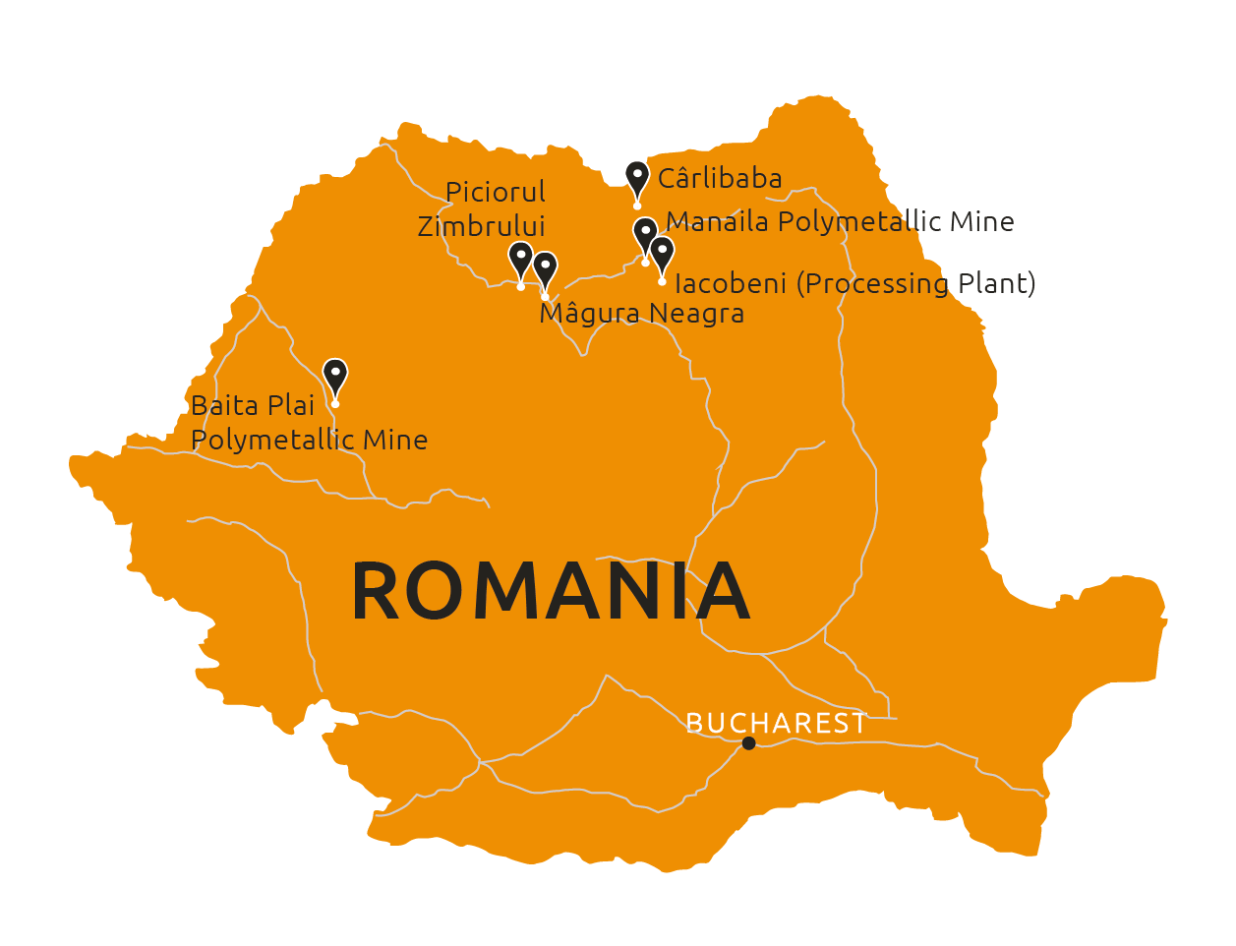
Manaila Polymetallic Mine

Slide 2
disclaimer
These materials do not constitute or form any part of any offer or invitation to sell or issue or purchase or subscribe for any shares in Vast Resources plc. (the “Company”) nor shall they or any part of them, or the fact of their distribution, form the basis of, or be relied on in connection with, any contract with the Company relating to any securities.
These materials have been prepared as a summary only and do not contain all information about the Company’s assets and liabilities, financial position and performance, profits and losses, prospects and rights and liabilities. No reliance may be placed for any purpose whatsoever on the information contained in these materials or on their completeness. Any reliance thereon could potentially expose you to a significant risk of losing all of the property invested by you or the incurring by you of additional liability. No representation or warranty, express or implied, is given by the Company, its directors or employees, or their professional advisers as to the accuracy, fairness, sufficiency or completeness of the information, opinions or beliefs contained in these materials. Save in the case of fraud, no liability is accepted for any loss, cost or damage suffered or incurred as a result of the reliance on such information, opinions or beliefs.
Certain statements and graphs throughout these materials are “forward‐looking statements” and represent the Company’s expectations or beliefs concerning, among other things, future operating results and various components thereof, including financial condition, results of operations, plans, objectives and estimates(including resource estimates), and the Company’s future economic performance. These statements, which may contain the words “anticipate”, “believe”, “intend”, “estimate”, “expect” and words of similar meaning, reflect the directors’ beliefs and expectations and involve a number of risks and uncertainties as they relate to events and depend on circumstances that will occur in the future. Forward‐looking statements speak only as at the date of these materials and no representation is made that any of these statements or forecasts will come to pass or that any forecast results will be achieved. The Company expressly disclaims any obligation to update or revise any forward‐looking statements in these materials, whether as a result of new information or future events.
If you are considering buying shares in the Company, you should consult a person authorised by the Financial Conduct Authority who specialises in advising on securities of companies such as Vast Resources plc.

Slide 3
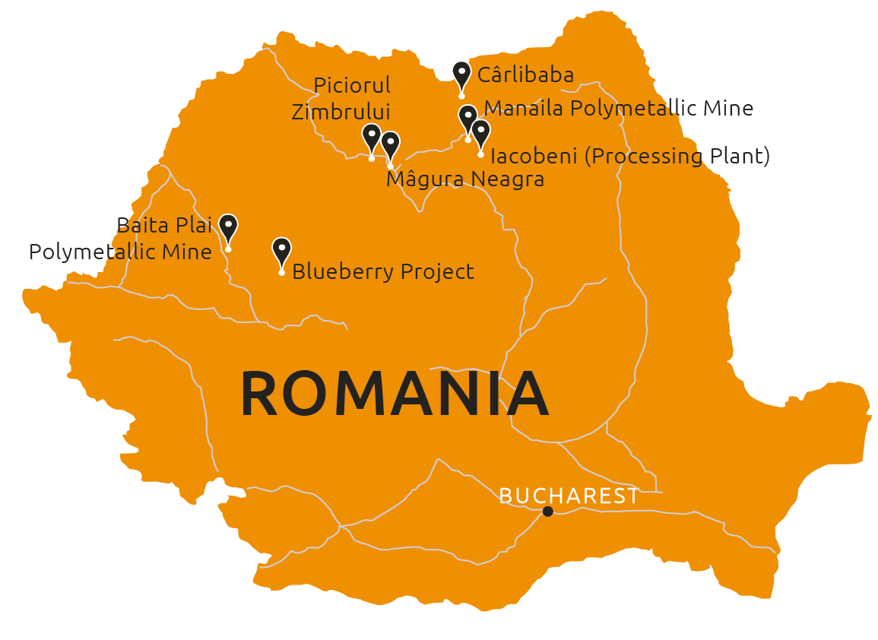
MANAILA POLYMETALLIC MINE
MINERAL RESOURCE
JORC RESOURCE ESTIMATE
100% interest in Manaila Polymetallic Mine
Total open pit Mineral Resource (Ind & Inf) of 4.6Mt at a grade of 0.97% Cu, 0.32% Pb, 0.68% Zn, 25.8g/t Ag and 0.23g/t Au at a 0.25% Cu cut-off
Total underground Mineral Resource (Ind & Inf) of 1.1Mt at a grade of 1.58% Cu, 0.82% Pb and 0.88% Zn, 14.6g/t Ag and 0.15g/t Au at a 1.00% Cu cut-off
Exploration Target defined for:
  Open pit of 1.1Mt-3.2Mt with grades ranging between 0.4-1.1% Cu, 0.1-0.4% Pb and 0.2-1.1% Zn
  Underground of 7.9Mt-23.6Mt with grades ranging between 0.4-1.3% Cu, 0.2-0.7% Pb and 0.3-1.0% Zn
Requires additional capital to re site plant and mine. Currently assessing expansion programme

Slide 4
Romanian expansion
Evaluation of previously producing mines and greenfield exploration to expand mineralised footprint across Romania and leverage first mover advantage
Piciorul Zimbrului & Magura Neagra (ZAGRA) prospecting licences
Prospecting activities commenced in October 2017 focussing on geological mapping of 7.6km of outcrop and confirmation of existing underground adits and infrastructure
Initial estimates related to the porphyry style mineralisation at Magura Neagra have indicated an exploration target (non JORC compliant) of up to 3,000mt of ore to a depth of 600m, at grades up to 0.8% Cu & 0.5g/t Au
Prospective drill programme completed and awaiting results to advance resource potential of the licences
REMIN
Relationship with Remin SA, the Romanian state mining company, enabling due diligence on Remin’s entire polymetallic and precious metal mineral interests consisting of 55 brownfield mining assets

Slide 5

Andrew Prelea | Chief Executive Officer
T: +44 (0) 20 7236 1177
Andrew Hall | Head of Corporate Development
T: +44 (0) 20 7236 1177
St Brides Partners |PR & IR
Catherine Leftley + Juliet Earl
T: +44 (0) 20 7236 1177

