Slide 1
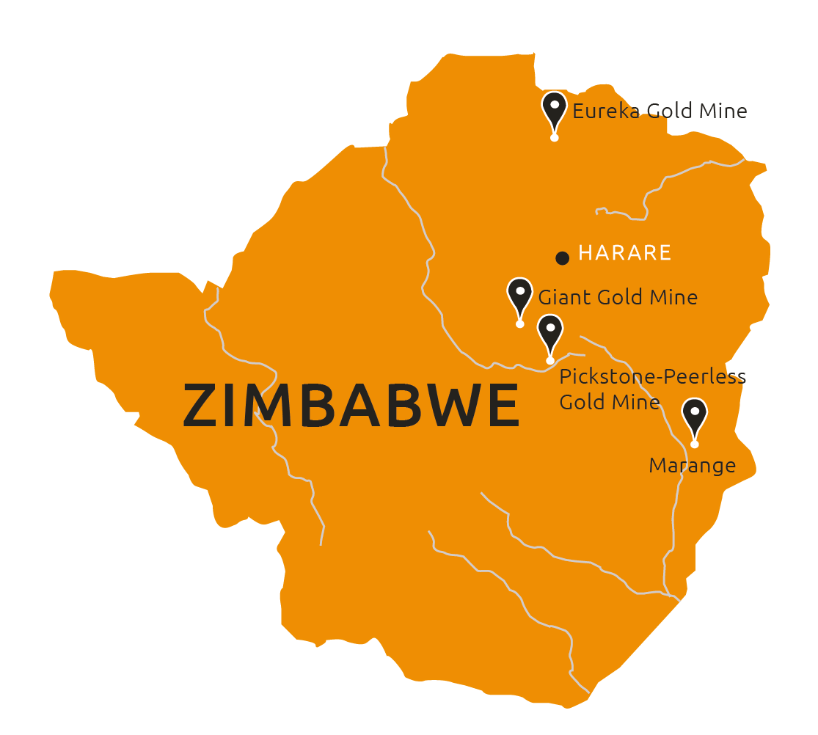
HERITAGE DIAMOND CONCESSION
Marange

Slide 2
disclaimer
These materials do not constitute or form any part of any offer or invitation to sell or issue or purchase or subscribe for any shares in Vast Resources plc. (the “Company”) nor shall they or any part of them, or the fact of their distribution, form the basis of, or be relied on in connection with, any contract with the Company relating to any securities.
These materials have been prepared as a summary only and do not contain all information about the Company’s assets and liabilities, financial position and performance, profits and losses, prospects and rights and liabilities. No reliance may be placed for any purpose whatsoever on the information contained in these materials or on their completeness. Any reliance thereon could potentially expose you to a significant risk of losing all of the property invested by you or the incurring by you of additional liability. No representation or warranty, express or implied, is given by the Company, its directors or employees, or their professional advisers as to the accuracy, fairness, sufficiency or completeness of the information, opinions or beliefs contained in these materials. Save in the case of fraud, no liability is accepted for any loss, cost or damage suffered or incurred as a result of the reliance on such information, opinions or beliefs.
Certain statements and graphs throughout these materials are “forward‐looking statements” and represent the Company’s expectations or beliefs concerning, among other things, future operating results and various components thereof, including financial condition, results of operations, plans, objectives and estimates(including resource estimates), and the Company’s future economic performance. These statements, which may contain the words “anticipate”, “believe”, “intend”, “estimate”, “expect” and words of similar meaning, reflect the directors’ beliefs and expectations and involve a number of risks and uncertainties as they relate to events and depend on circumstances that will occur in the future. Forward‐looking statements speak only as at the date of these materials and no representation is made that any of these statements or forecasts will come to pass or that any forecast results will be achieved. The Company expressly disclaims any obligation to update or revise any forward‐looking statements in these materials, whether as a result of new information or future events.
If you are considering buying shares in the Company, you should consult a person authorised by the Financial Conduct Authority who specialises in advising on securities of companies such as Vast Resources plc.

Slide 3
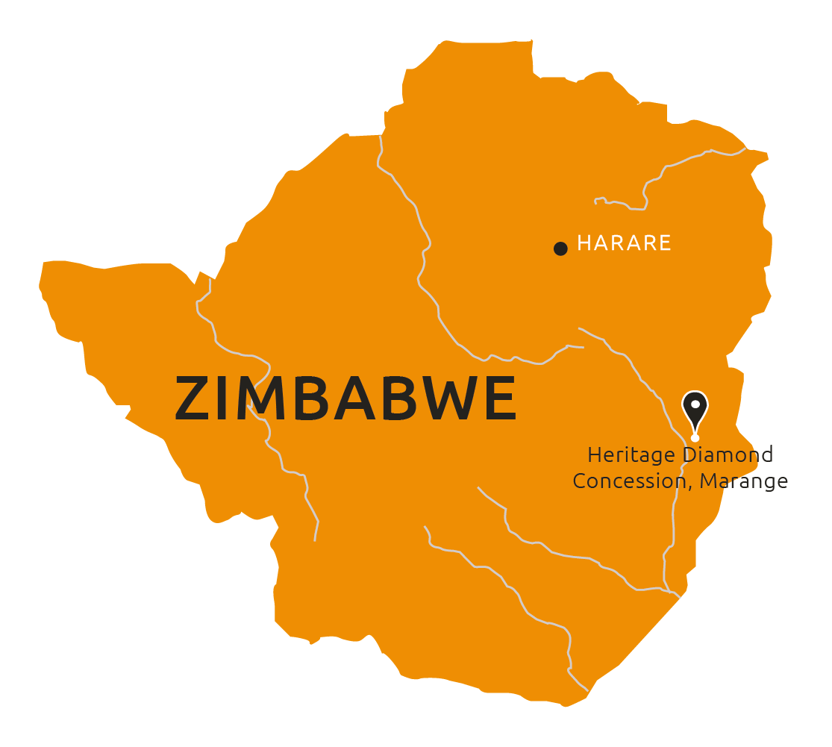
HERITAGE DIAMOND CONCESSION
The Marange Diamond Fields is widely regarded as the richest alluvial diamond deposit globally
JV to unlock the potential of the Heritage Diamond Concession
Agreement between Vast and the Chiadzwa Community Development Trust relating to exclusive access to the 15km² Heritage Concession in the Marange Diamond Fields
JV to be established with a view to Vast developing, mining and marketing diamonds produced from the concession on a profit share basis with Vast receiving a minimum of 59% and up to 75% of profits including management fees
Unmined concession which by virtue of its geographical positioning is anticipated to contain economically viable diamondiferous alluvials as well as conglomerate ore resources
MOU signed with Botswana Diamonds plc (AIM: BOD) with the intention of:
Developing diamond resources within the Marange Diamond Fields through an SPV – initial shareholdings will be Botswana Diamonds 13.33% and Vast 86.67%
Botswana will provide free of charge assistance in interpretation of geological and other information concerning the Heritage site including the marketing of diamonds
Vast will contribute up to $1 million on loan account as the first funding to the SPV – if any funds are required in addition to $1 million, Botswana and Vast have the right to contribute pro rata to their shareholdings and if either party does not want to take up its full allocation the other party has the right to take up the allocation

Slide 4
HERITAGE DIAMOND CONCESSION
ILLUSTRATIVE POSSIBILITIES
Independent geological assessment obtained September 2018 giving indicative grades
Vast Diamond division employs team of three senior personnel who each have several years experience mining in the Marange Diamond Fields
Mark Mabhudhu – CEO: former CEO of Government owned Zimbabwe Consolidated Diamond Company (ZCDC) and of Marange Resources
Rudorwenyu Mandinyenya – Mining Engineer: previously leader of production team at Marange Resources
Takawira Zhou – Mining Geologist: previously managing all technical functions of the diamond operation at ZCDC and Marange Resources
Takawira Zhou has written a Rhodes University thesis on the geology and a regional diamond exploration in the Marange Diamond Fields including Heritage Concession
The Vast diamond division team have prepared a business case on the Heritage Concession and drawn up a list of projections based on their knowledge and experience
The base case projections assume a grade of 50 carats/100 tonnes and a sales price of US$60/carat. Independent geological assessment quoted grades for the area as typically 100-200 carats/100 tonnes and average prices of US$80/carat
Projections indicate revenue after six months of US$15 million per quarter on expenditure of US$6 million per quarter after capex of US$10 million*
*
This is a preliminary illustrative projection using information and experience currently available to the Company to demonstrate potential at the Heritage Concession. Commission is subject to licence and funding. The projections are subject to many uncertainties and may not be achieved. Readers are referred to the disclaimer at the front of this presentation.

Slide 5
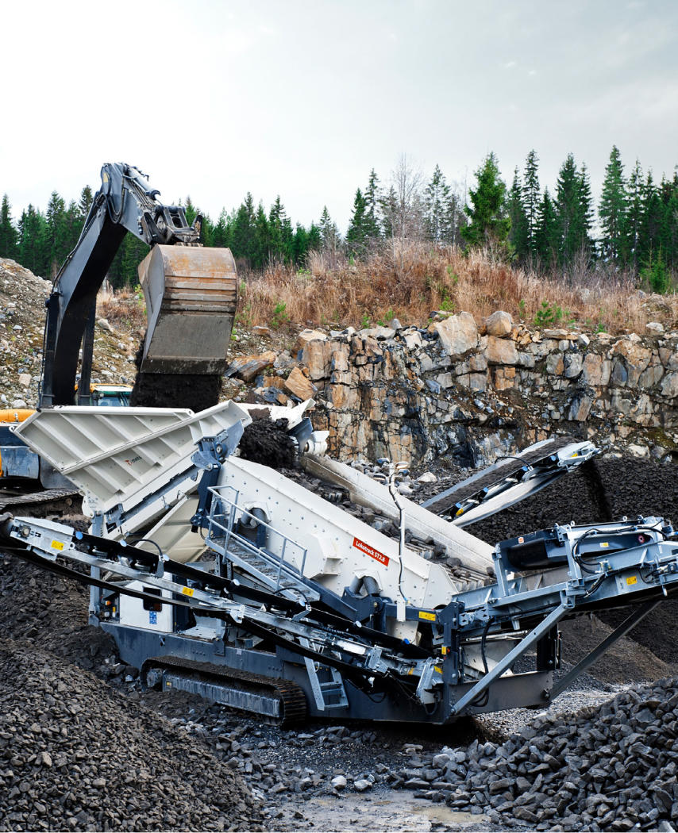
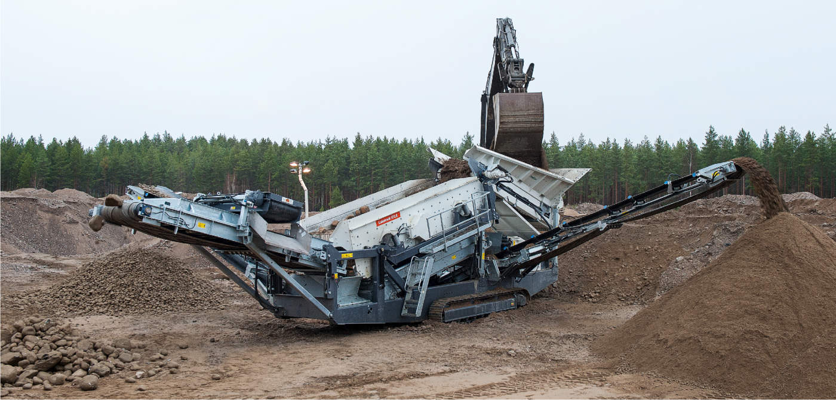
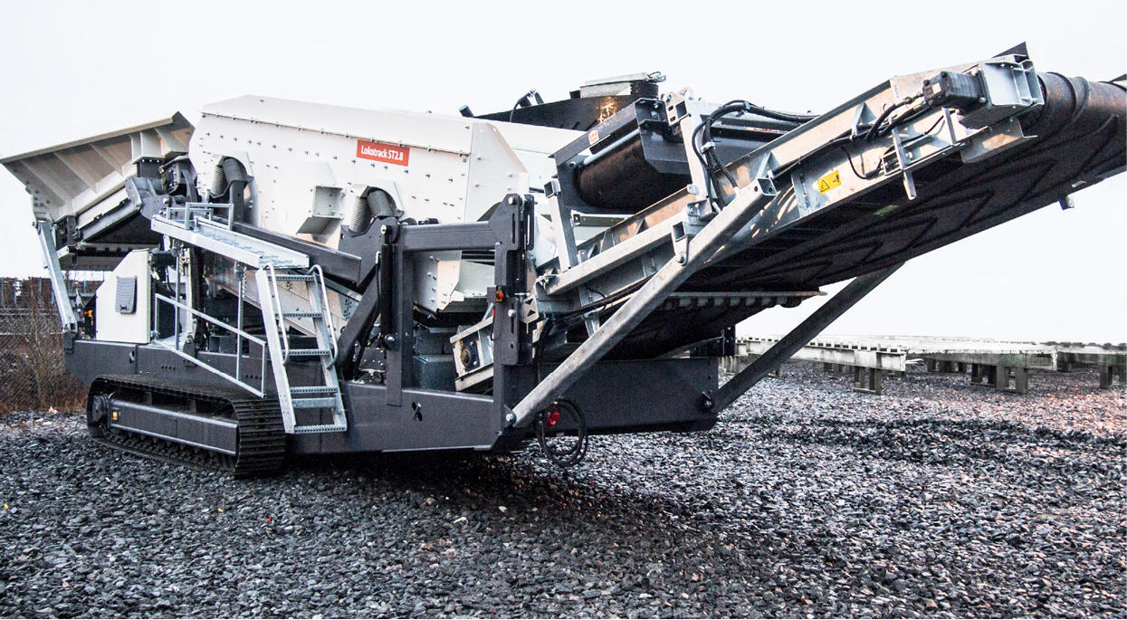
Typical mobile diamond screening plant

Slide 6
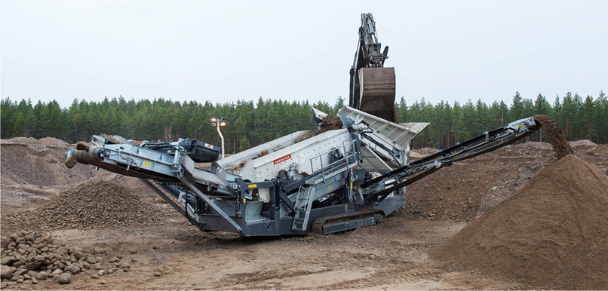
Proposed diamond process plant
MOBILE SCREEN

Slide 7
Andrew Prelea | Chief Executive Officer
T: +44 (0) 20 7236 1177
Andrew Hall | Head of Corporate Development
T: +44 (0) 20 7236 1177
St Brides Partners |PR & IR
Catherine Leftley + Juliet Earl
T: +44 (0) 20 7236 1177

