Slide 1
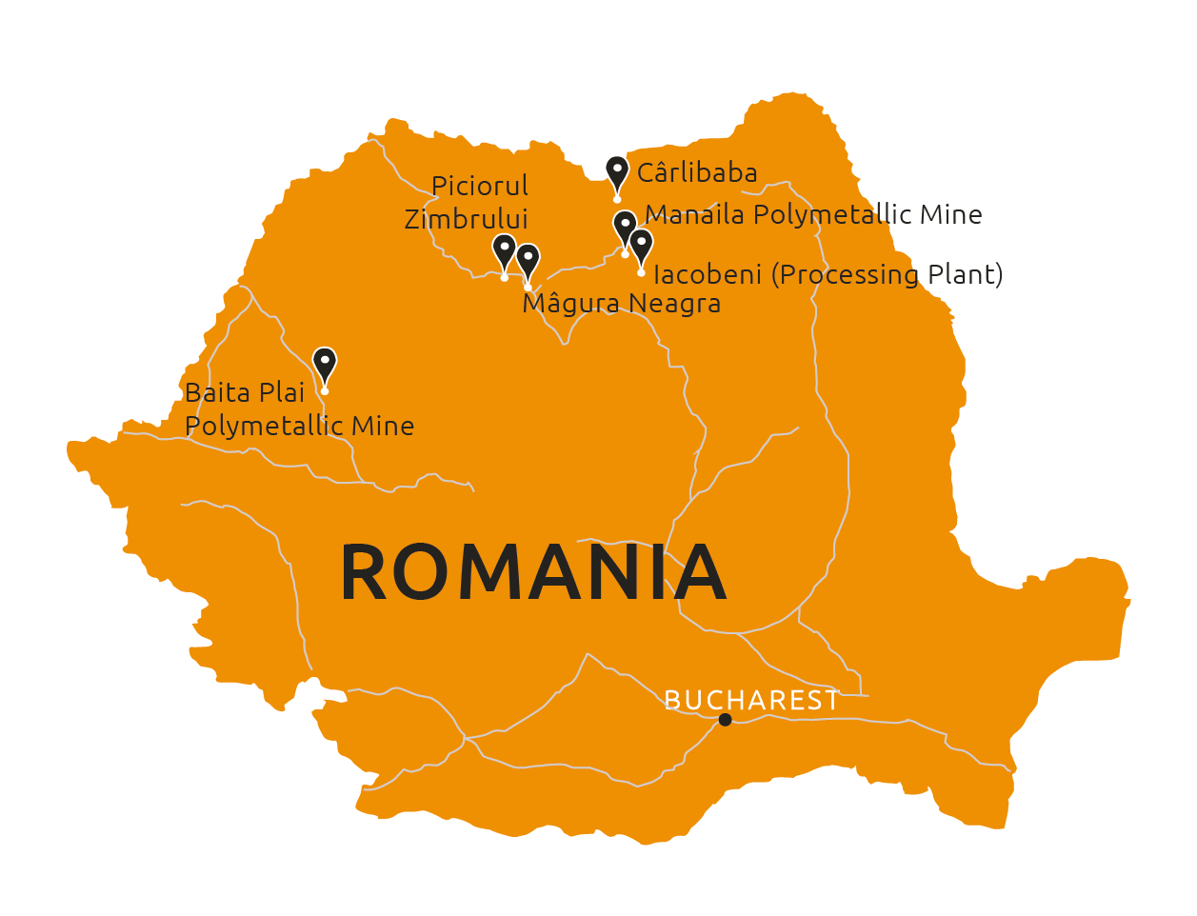
Blueberry

Slide 2
disclaimer
These materials do not constitute or form any part of any offer or invitation to sell or issue or purchase or subscribe for any shares in Vast Resources plc. (the “Company”) nor shall they or any part of them, or the fact of their distribution, form the basis of, or be relied on in connection with, any contract with the Company relating to any securities.
These materials have been prepared as a summary only and do not contain all information about the Company’s assets and liabilities, financial position and performance, profits and losses, prospects and rights and liabilities. No reliance may be placed for any purpose whatsoever on the information contained in these materials or on their completeness. Any reliance thereon could potentially expose you to a significant risk of losing all of the property invested by you or the incurring by you of additional liability. No representation or warranty, express or implied, is given by the Company, its directors or employees, or their professional advisers as to the accuracy, fairness, sufficiency or completeness of the information, opinions or beliefs contained in these materials. Save in the case of fraud, no liability is accepted for any loss, cost or damage suffered or incurred as a result of the reliance on such information, opinions or beliefs.
Certain statements and graphs throughout these materials are “forward‐looking statements” and represent the Company’s expectations or beliefs concerning, among other things, future operating results and various components thereof, including financial condition, results of operations, plans, objectives and estimates(including resource estimates), and the Company’s future economic performance. These statements, which may contain the words “anticipate”, “believe”, “intend”, “estimate”, “expect” and words of similar meaning, reflect the directors’ beliefs and expectations and involve a number of risks and uncertainties as they relate to events and depend on circumstances that will occur in the future. Forward‐looking statements speak only as at the date of these materials and no representation is made that any of these statements or forecasts will come to pass or that any forecast results will be achieved. The Company expressly disclaims any obligation to update or revise any forward‐looking statements in these materials, whether as a result of new information or future events.
If you are considering buying shares in the Company, you should consult a person authorised by the Financial Conduct Authority who specialises in advising on securities of companies such as Vast Resources plc.

Slide 3
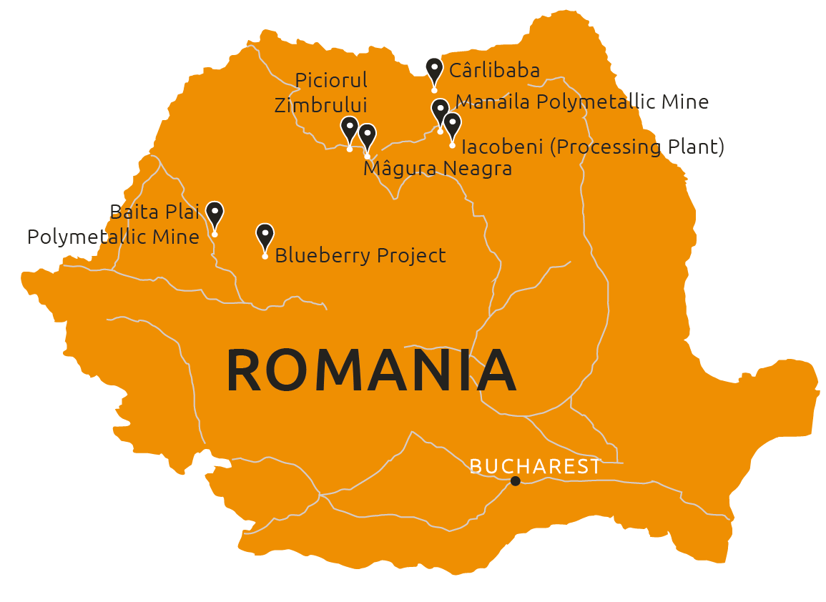
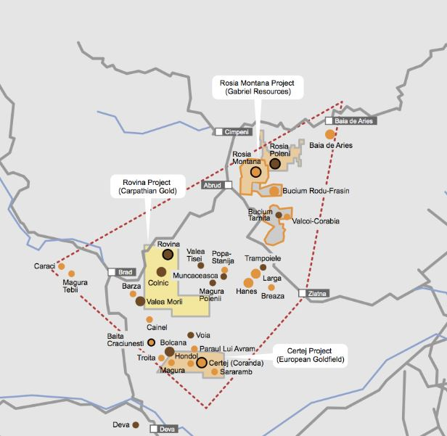
Blueberry project
Highly prospective brownfield in the heart of Romania’s ‘Golden Quadrilateral’ which has been estimated to have produced up to 55 million ounces of gold to date
*
A brown field perimeter covering a total of 7.285km² in the ‘Golden Quadrilateral’ of Western Romania
Hosts highly prospective polymetallic mineralisation
Sample values of up to 22.4g/t of gold were obtained from historic soil sampling
Drilling programme and assaying underway, which is anticipated to deliver sufficient information to support an Inferred JORC Mineral Resource
Opportunity to advance subsidiary which holds the project into a standalone enterprise with a potential IPO targeted

Slide 4
blueberry development
Accelerated development plan aimed at proving up the Resource potential of Blueberry and establishing it as a standalone mining enterprise via IPO
Soil sampling programme completed and confirmed anomalous gold in soil values and extended and defined the target footprint in more detail
Continued progress towards defining maiden JORC Compliant Resource Estimate targeted for completion once all assay results have been received
Targeting the application of an Exploitation Licence when drill report is completed
Anticipated launch of IPO process of EMA, Vast’s subsidiary company which holds the Blueberry Project, in H2 2019 to crystallise the value of this pre-production asset
Q1 2019 Drilling Highlights
6.20m @ 1.99g/t Au and 3.24g/t Ag, from 47.6m to 53.8m
16.0m @ 2.95 g/t Au from 190.0m to 206.0m
39.0m @ 2.42 g/t Au and 11.47 g/t Ag, from 108.0m to 147.0m
15.0m @ 1.64g/t Au and 9.44 g/t Ag from 137.0m to 152.0m
0.5m @ 9.83g/t Au, 147.0g/t Ag, 18.90% Pb and 32.50% Zn from 41.0m to 41.5m

Slide 5
Andrew Prelea | Chief Executive Officer
T: +44 (0) 20 7236 1177
Andrew Hall | Head of Corporate Development
T: +44 (0) 20 7236 1177
St Brides Partners |PR & IR
Catherine Leftley + Juliet Earl
T: +44 (0) 20 7236 1177

