Slide 1
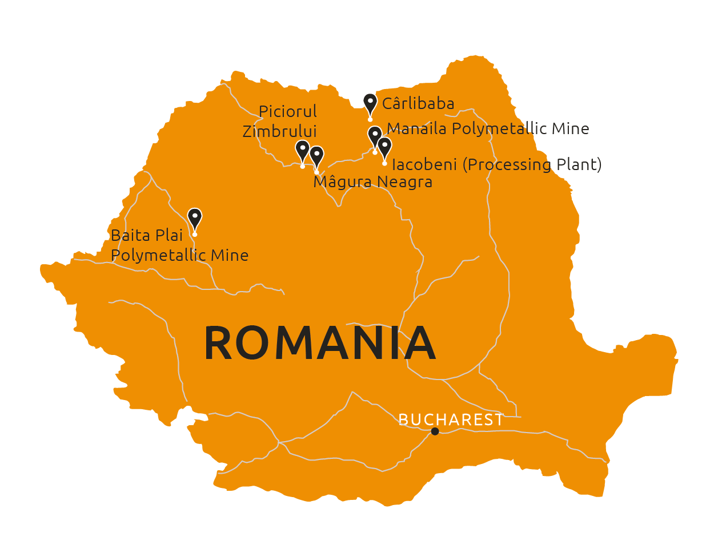
Baita Plai Polymetallic Mine

Slide 2
disclaimer
These materials do not constitute or form any part of any offer or invitation to sell or issue or purchase or subscribe for any shares in Vast Resources plc. (the “Company”) nor shall they or any part of them, or the fact of their distribution, form the basis of, or be relied on in connection with, any contract with the Company relating to any securities.
These materials have been prepared as a summary only and do not contain all information about the Company’s assets and liabilities, financial position and performance, profits and losses, prospects and rights and liabilities. No reliance may be placed for any purpose whatsoever on the information contained in these materials or on their completeness. Any reliance thereon could potentially expose you to a significant risk of losing all of the property invested by you or the incurring by you of additional liability. No representation or warranty, express or implied, is given by the Company, its directors or employees, or their professional advisers as to the accuracy, fairness, sufficiency or completeness of the information, opinions or beliefs contained in these materials. Save in the case of fraud, no liability is accepted for any loss, cost or damage suffered or incurred as a result of the reliance on such information, opinions or beliefs.
Certain statements and graphs throughout these materials are “forward‐looking statements” and represent the Company’s expectations or beliefs concerning, among other things, future operating results and various components thereof, including financial condition, results of operations, plans, objectives and estimates(including resource estimates), and the Company’s future economic performance. These statements, which may contain the words “anticipate”, “believe”, “intend”, “estimate”, “expect” and words of similar meaning, reflect the directors’ beliefs and expectations and involve a number of risks and uncertainties as they relate to events and depend on circumstances that will occur in the future. Forward‐looking statements speak only as at the date of these materials and no representation is made that any of these statements or forecasts will come to pass or that any forecast results will be achieved. The Company expressly disclaims any obligation to update or revise any forward‐looking statements in these materials, whether as a result of new information or future events.
If you are considering buying shares in the Company, you should consult a person authorised by the Financial Conduct Authority who specialises in advising on securities of companies such as Vast Resources plc.

Slide 3
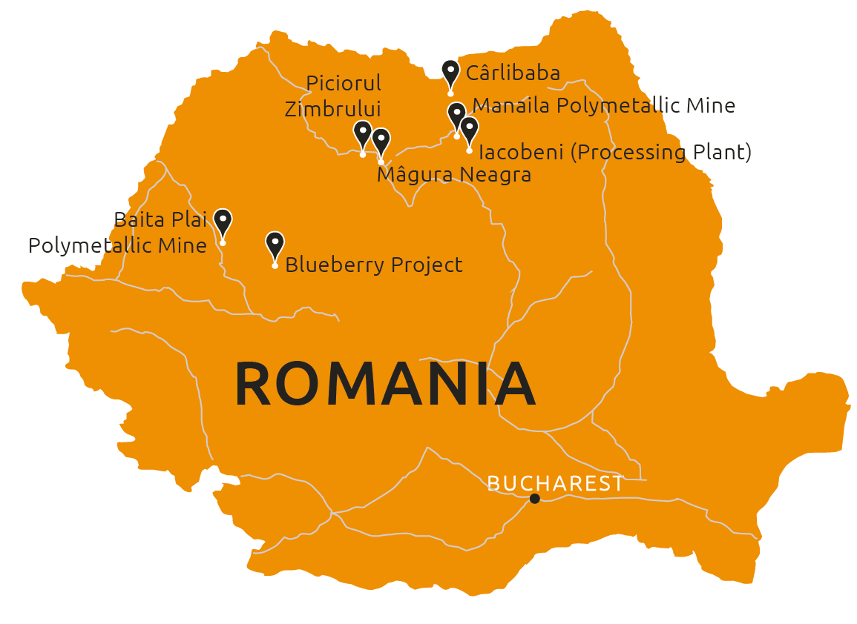
Baita plai polymetallic mine
Vast owns 80% of the asset
Official mineral resources (NAEN Code) for Baita Plai as recorded are reported as 1.8Mt at grades of 2.19% Cu, 3.07% Pb, 3.46% Zn, 1.41 g/t Au and 128.2 g/t Ag.
The mineral resources are classified as 1.27Mt C1 resources and 0.61Mt C2 resources under the Russian Mineral Resource reporting system (the ‘NAEN’ code).
In broad terms, a C1 resource is equivalent to the Australian Joint Ore Resources Committee (the ‘JORC’ code) Indicated mineral resource while a C2 is broadly equivalent to an Inferred mineral resource.
Of the 1.27Mt C1 resources, 0.64Mt are located within the main Antonio pipe or skarn where production is targeted to recommence.
Historical assay data from the mine, assayed at ALS Laboratories in Rosia Montana, Romania, is currently being captured to create an assay sample database suitable for JORC mineral resource estimation in the near future.
Unmeasured resources in other pipes and substantial exploration upside.

Slide 4
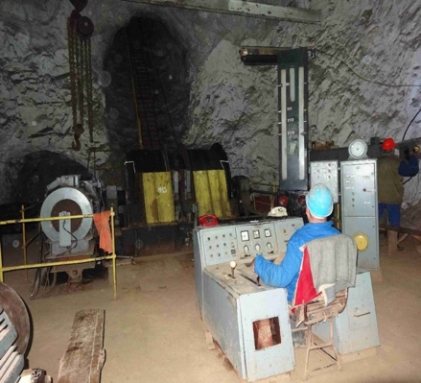
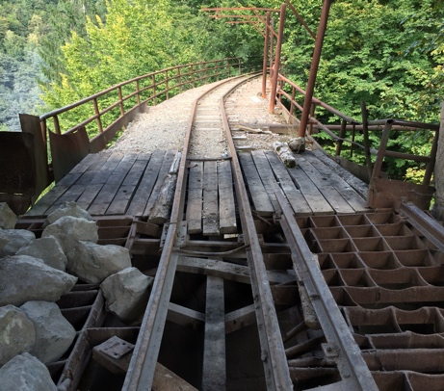
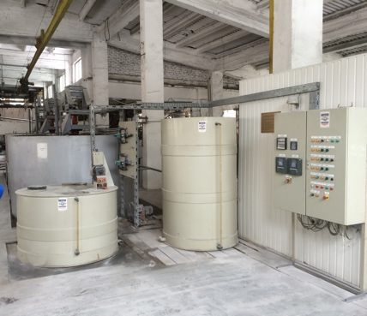
Baita plai polymetallic mine
Implied value of more than 8 x investment to date
Investment of less than US$4.5 million to date for acquisition, care and maintenance, legal fees, improvements and allocation of overhead
Further US$3.5 million budgeted for re-start capex including underground drilling
Vast has acquired 60 years of infrastructure development and investment that is estimated would cost more than US$50 million to replace and take 5-10 years to build today
Implied value to Vast shareholders is more than 8 times outlay to bring asset into production in the near term
TARGET TO REOPEN MINE
IN MID-2019
Underground hoist chamber
1km tramway to processing plant
Processing plant comprising crushing, milling and flotation circuits

Slide 5
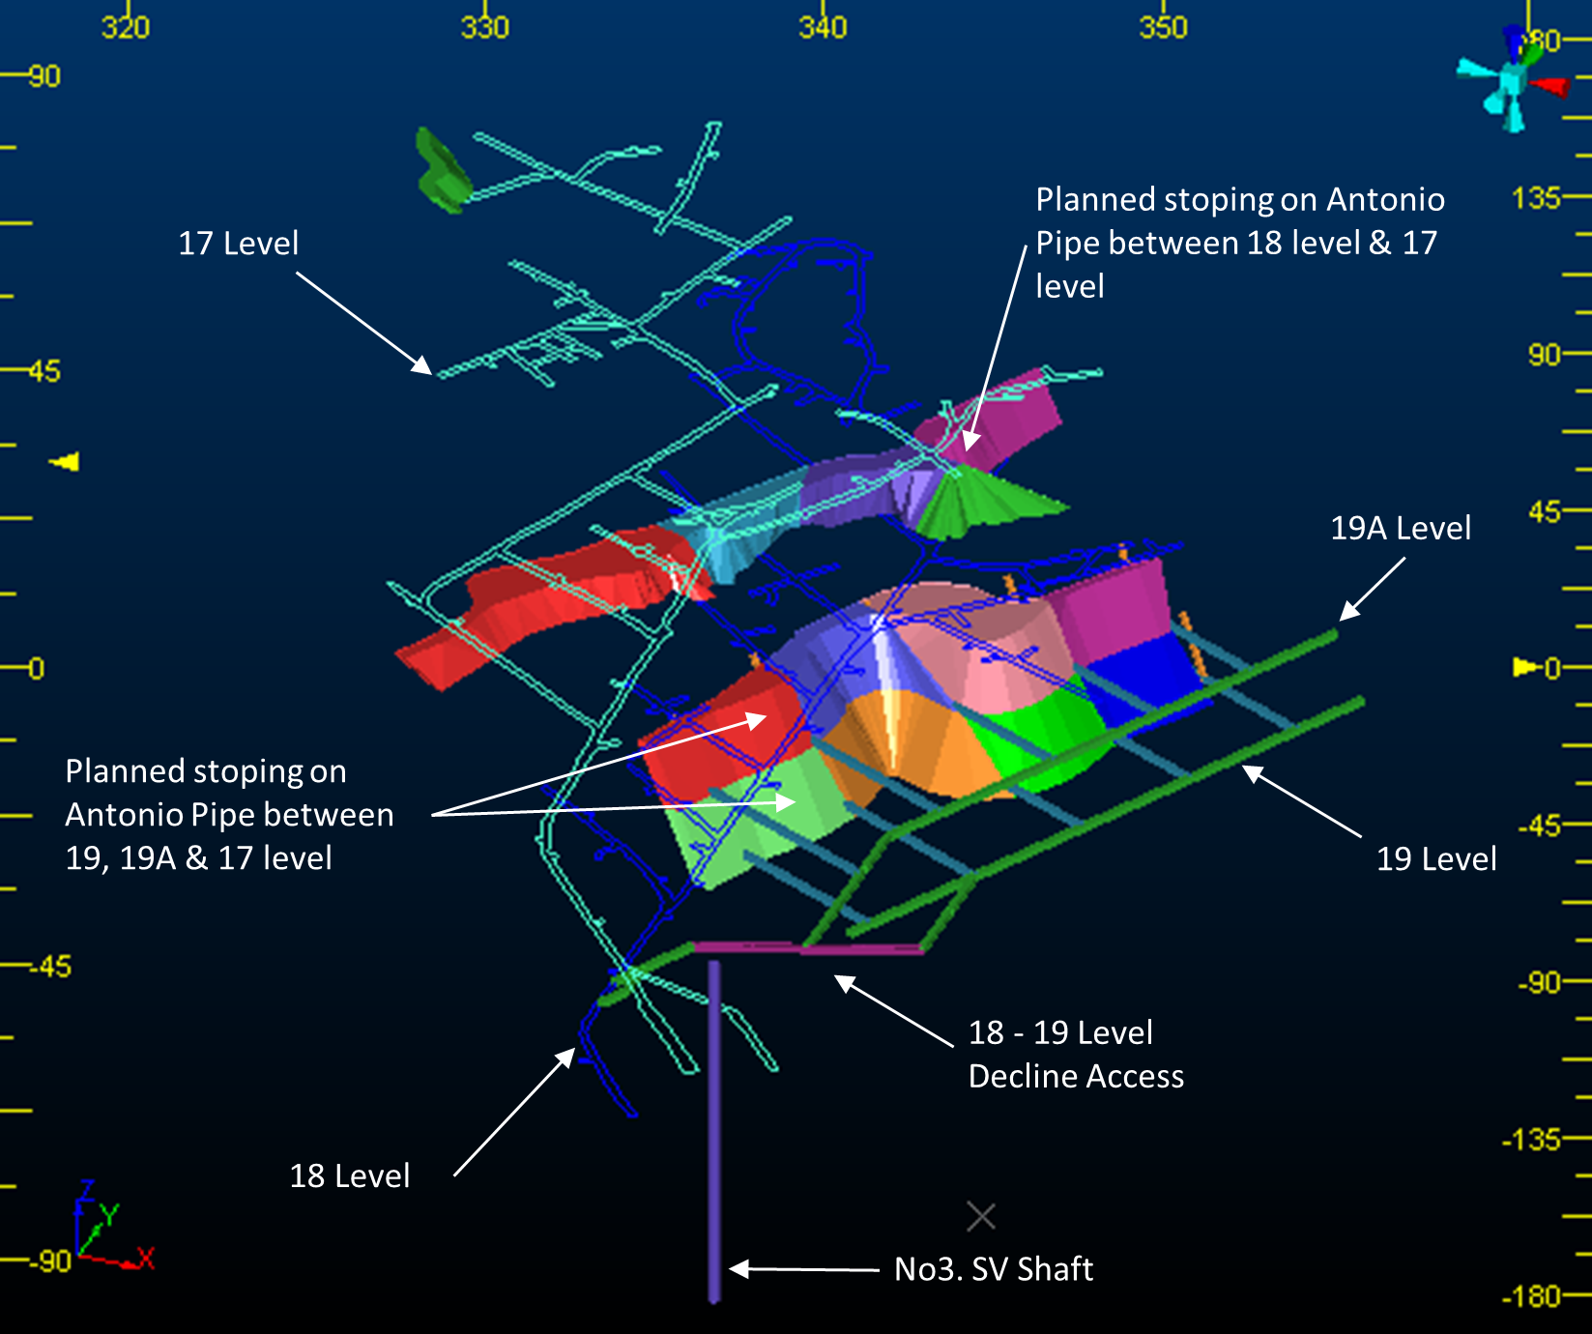
Baita Plai Indicative production plan
Startup team deployed for Startup Indicative Production Plan which exploits currently accessible mining areas only
A production plan for Baita Plai (BP Plan) has been developed on the following basis :
Utilises the non-JORC compliant NAEN code mineral resource in the absence of a mineral resource block model.
Defined the orebody outline in the areas targeted for commencing production from actual mining and geology plans.
Developed a mining schedule utilising Mine24D based on the orebody defined above.
Determined mining costs utilising actual labour rates from the Manaila operation together with actual consumable item costs as sourced for Manaila.
Utilised the average of the process plant recovery factors and concentrate grades from the last 8 years of production.
Obtained quotes from Romanian and Chinese suppliers for the Capital Expenditure equipment requirements.
The plan has been produced by Craig Harvey, the Chief Operating Officer for Vast and a full time employee and director of the Company. Craig Harvey is a Competent Person who is a member of the Australian Institute of Geoscientists and of the Geological Society of South Africa

Slide 6
Indicative production plan - PROJECTIONS*
Expected concentrate grades based on historical recovery percentages
Cu Concentrate
Zn Concentrate
Pb Concentrate
*
These internal projections are developed from the BP Plan compiled by Craig Harvey, the Chief Operating Officer for Vast and a full time employee and director of the Company. Craig Harvey is a Competent Person who is a member of the Australian Institute of Geoscientists and of the Geological Society of South Africa. These projections are initial forecasts calculated using the information currently available in order to demonstrate the potential production profile and returns available once commissioning commences at Baita Plai. The actual results are subject to many uncertainties, these projections may not be achieved, and readers are referred to the disclaimer at the front of this presentation.
The illustrative calculations set out above are not based on a mineral resource estimate that has been prepared in accordance with the Group’s adopted AIM Standard (JORC) and is not a feasibility report prepared under such standard. Accordingly, this should be treated with caution by investors until such time as resources can be reported in accordance with such standard.

Slide 7
Expected development schedule*
An accelerated schedule aimed at delivering
cash flow within six months
Month | 0 | 1 | 2 | 3 | 4 | 5 | 6
Underground
General Revision
Preparing open stopes
Access points
Collection Points
Railway
Machinery Order/Delivery
Mining Equimpent
Flotation
Crushers
Mills
Classifiers
Hydrocyclons
Flotation cells
Filters
Pumps
Electricals including new secondary cable
Pumps
Laboratory
Tailings Dam
General maintainance
New pipeline from flotation
*
Anticipated development schedule subject to funding

Slide 8

Andrew Prelea | Chief Executive Officer
T: +44 (0) 20 7236 1177
Andrew Hall | Head of Corporate Development
T: +44 (0) 20 7236 1177
St Brides Partners |PR & IR
Catherine Leftley + Juliet Earl
T: +44 (0) 20 7236 1177

